Slide 1

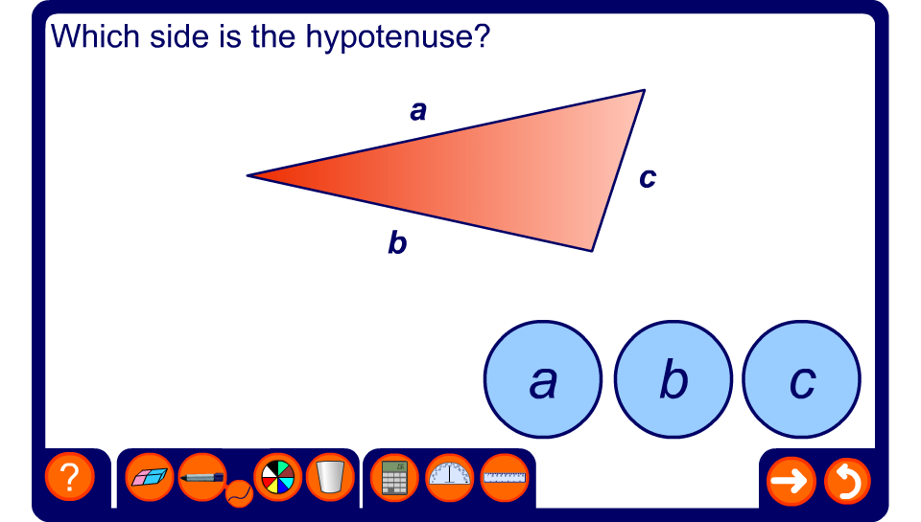


Identify the hypotenuse
Notes:
Use this exercise to identify the hypotenuse in right-angled triangles in various orientations.

